Slide 1

anyinfo
-All information at one site
Team 7 SHRESHT​

Slide 2
Problem Statement
-General Public Information
Why can’t we find all different places at one site???
Is it possible for a person to explore different places in a faster and easier way??

Slide 3

Solution!
In this busy world people are having hectic schedule.. so, for availability of all kind of general information such as schools, hospitals, malls, restaurants……..at one place!
Here comes our website, AnyInfo

Slide 4

Target Audience
It is for all kind of people which includes
travellers, information junkies, studious,
shopaholics…etc

Slide 5
Market Value
There has always been demand for general information sites, as data can be accessed quickly in a matter of minutes by the users. There’s been a study rise in the income of such websites.

Slide 6
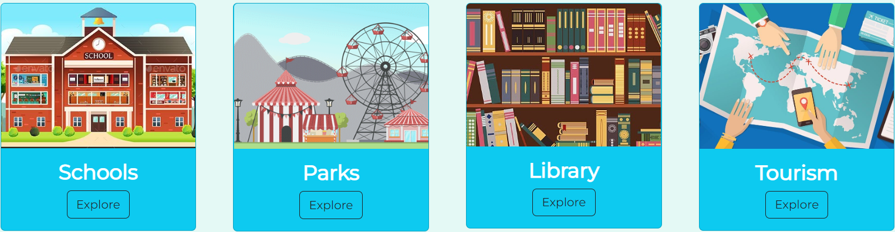

Unique Features
Easy Navigation and Accessible.
Organising the information by Cards.
Grabbing the attention by GIF’s.
Upgrading the page through Feedbacks.

Slide 7
we built anyinfo with
HTML
CSS
BOOTSTRAP
JAVASCRIPT
GITHUB
Basic Layout
Styling
Advanced Styling
Login, Signup pages
Hosting

Slide 8
Tabs
Home Page
Login Page
Restaurants
Hospitals
Malls
Police
Schools
Parks
Library
Tourism
Feedback Form

Slide 9
TEAM
T. Anu Shree
K. L. V. R. S
B. Rishitha
P. Shiva Reddy
P. Dhruvateja
Passionate
Creative
Amiable
Ambitious
Focused

Slide 10
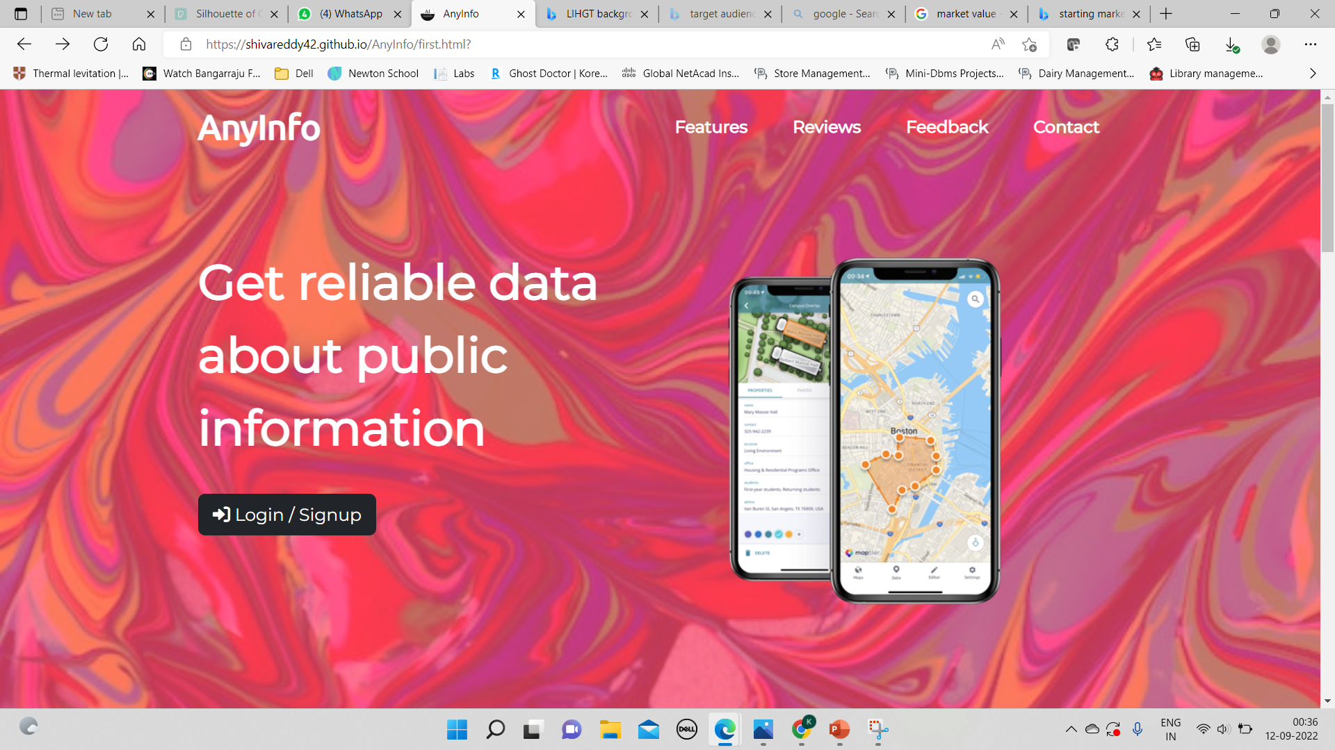
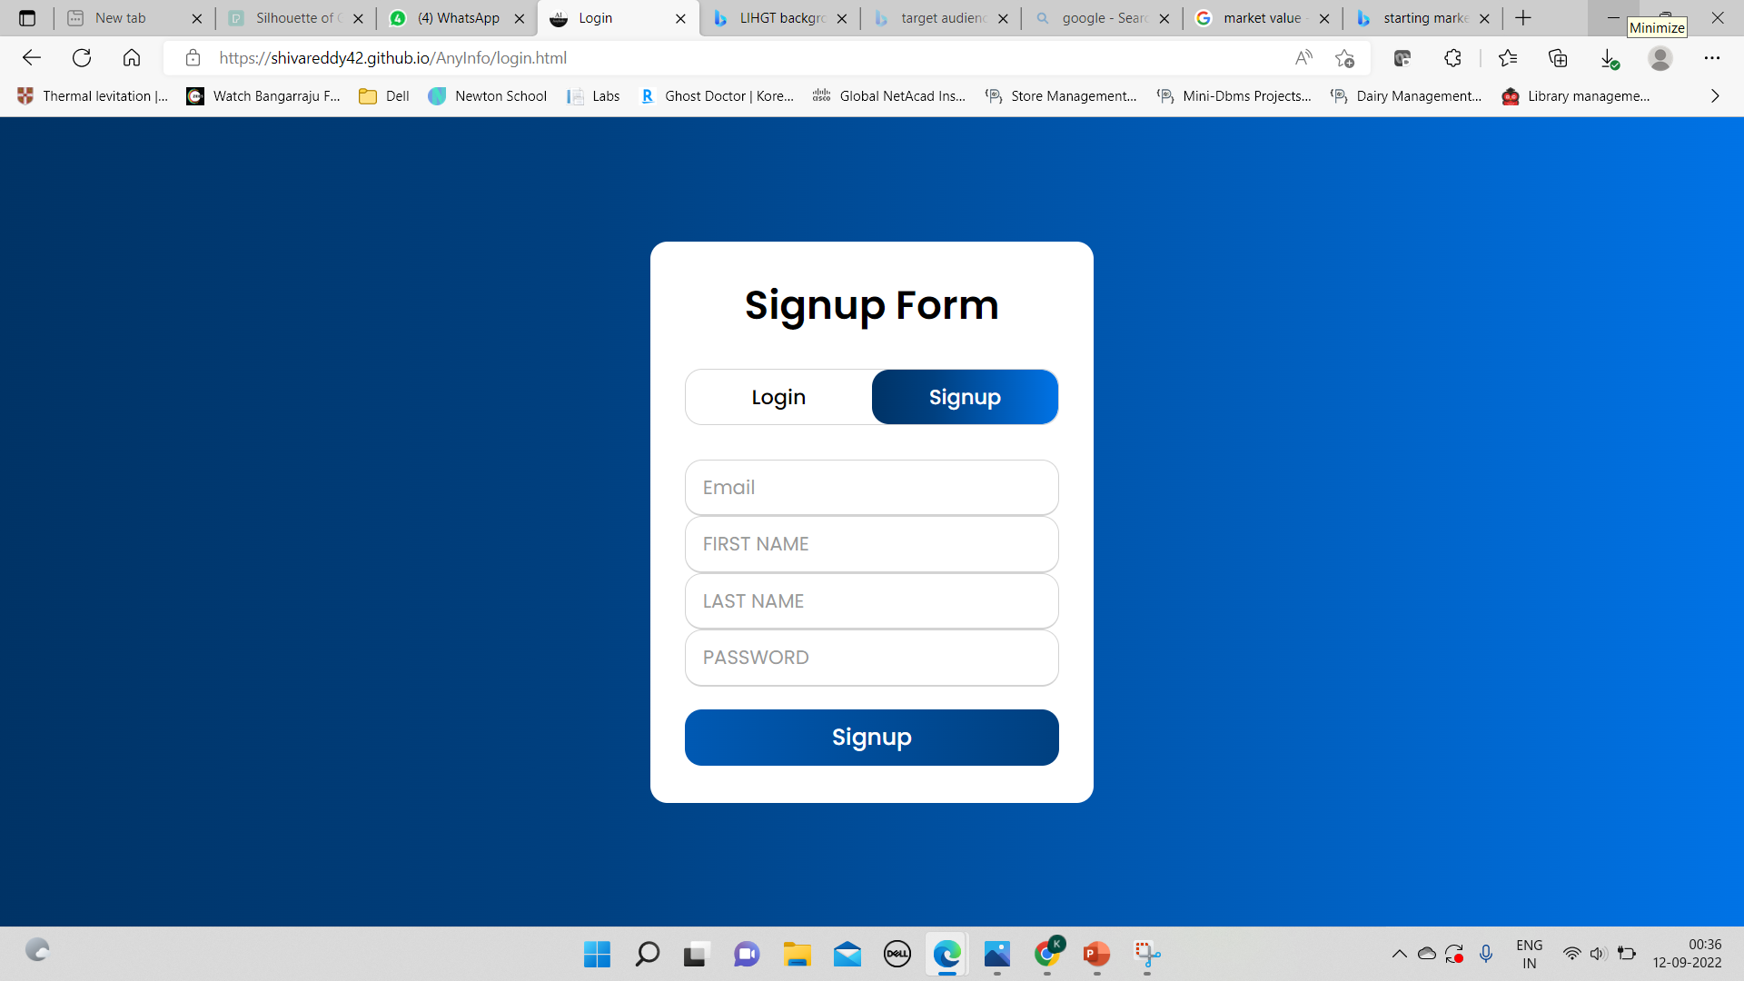
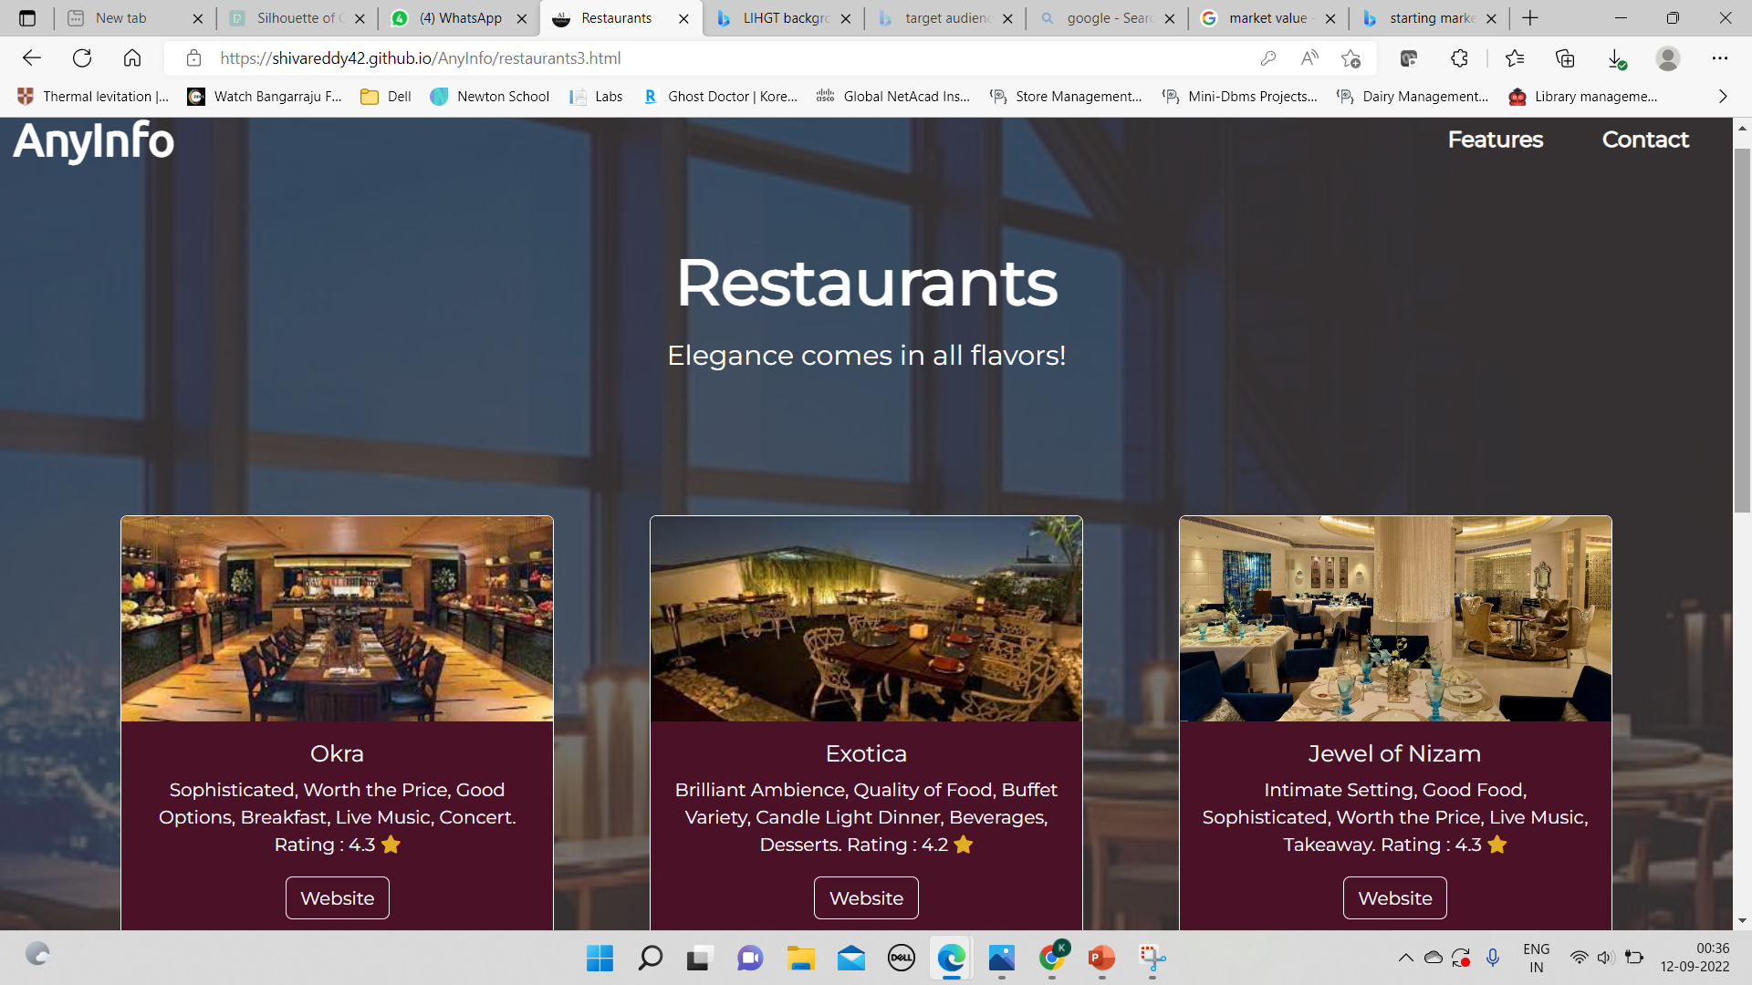
Sample visuals

Slide 11
conclusion
Our AnyInfo page is useful for all catogeries of people who can access different zones of places like Restaurants, Parks, Malls, Schools, Hospitals, Police Stations, Libraries and Tourist places in a easier, faster and less cumbersome manner.

Slide 12
THANK YOU
AnyInfo (shivareddy42.github.io)

